Slide 1
CNN
CONVOLUTIONAL NEURAL NETWORKS

Slide 2
CNN
A Convolutional Neural Network (ConvNet/CNN) is a Deep Learning algorithm that can
take in an input image
assign importance (learnable weights and biases) to various aspects/objects in the image
and be able to differentiate one from the other
The pre-processing required in a ConvNet is much lower as compared to other classification algorithms
While in canonical/classical ML algorithms, features are hand-engineered with enough training
ConvNets have the ability to learn these features/filters/characteristics.
THERE IS NO NEED TO EXTRACT FEATURES IN CNNs!

Slide 3
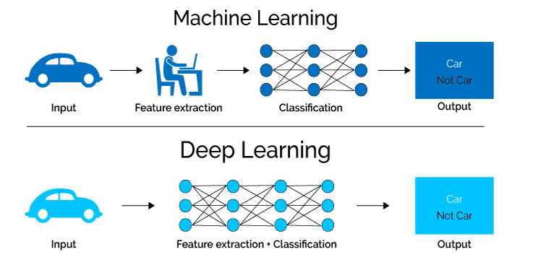
CNN
THERE IS NO NEED TO EXTRACT FEATURES MANUALLY IN CNNs!

Slide 4
CNN
The architecture of a ConvNet is analogous to that of the connectivity pattern of Neurons in the Human Brain
and was inspired by the organization of the Visual Cortex
Individual neurons respond to stimuli only in a restricted region of the visual field known as the Receptive Field
A collection of such fields overlap to cover the entire visual area
The basic idea is to extract local features and then combine them to make more complex patterns.

Slide 5
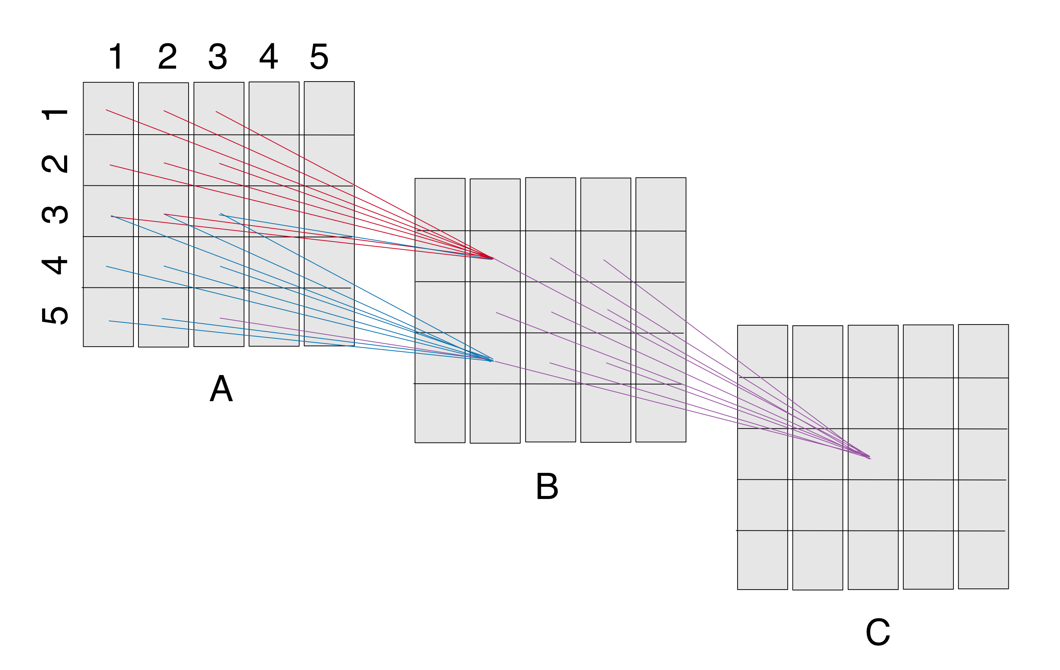
CNN
The “receptive field” of a “neuron” in a layer
would be the cross section
of the previous layer
from which neurons provide inputs
the receptive field of B(2,2) is the square A(1:3,1:3)
the receptive field of B(4,2) is the square A(3:5,1:3)
the receptive field of C(3,3) is B(2:4,2:4)
The filter size here is 3x3

Slide 6
CNN
A ConvNet is able to successfully capture the Spatial and Temporal dependencies in an image through the application of relevant filters
The architecture performs a better fitting to the image dataset due to the reduction in the number of parameters involved and the reusability of weights
In other words, the network can be trained to understand the sophistication of the image better

Slide 7
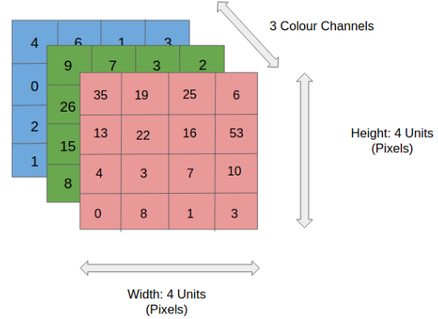
CNN
In the adjacent figure, we have an RGB image that has been separated by its three colour planes — Red, Green, and Blue
The role of ConvNet is to reduce the images into a form that is easier to process, without losing features that are critical for getting a good prediction
This is important when we are to design an architecture that is not only good at learning features but also scalable to massive datasets
Suppose that we have an 8K (7680x4320) image
CovNets can reduce the size of the image without losing important features

Slide 8
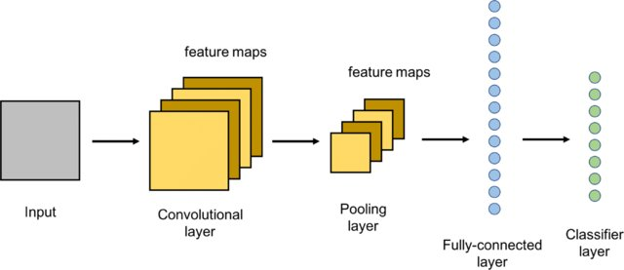
CNN – General Architecture
A CNN architecture consists of 3 main layers:
Convolutional layer
Pooling layer
Fully-connected (FC) layer

Slide 9
CNN – Convolutional Layer
The convolutional layer is the first layer of a convolutional network.
While convolutional layers can be followed by additional convolutional layers or pooling layers, the fully-connected layer is the final layer.
With each layer, the CNN increases in its complexity, identifying greater portions of the image.
Earlier layers focus on simple features, such as colours and edges.
As the image data progresses through the layers of the CNN, it starts to recognize larger elements or shapes of the object until it finally identifies the intended object.

Slide 10
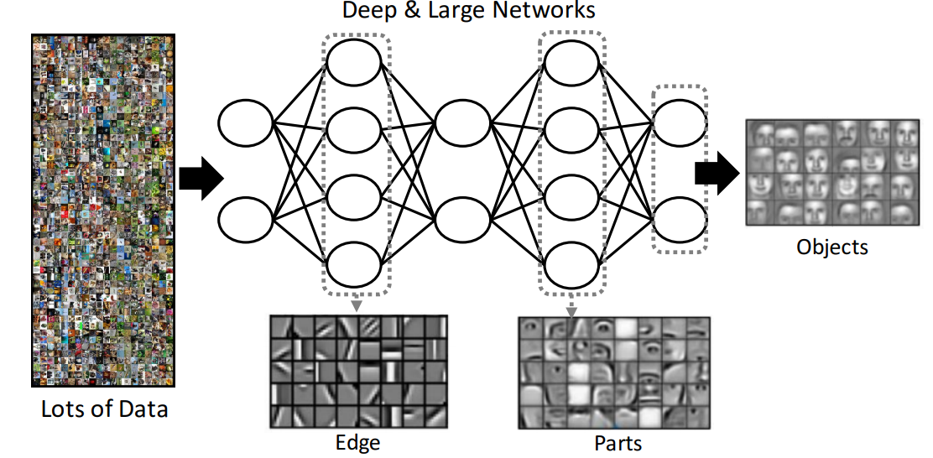
CNN – Convolutional Layer
As the image data progresses through the layers of the CNN, it starts to recognize larger elements or shapes of the object until it finally identifies the intended object.
BASIC FEATURES → COMPLEX FEATURES

Slide 11
CNN – Convolutional Layer
The convolutional layer is the core building block of a CNN, and it is where the majority of computation occurs
It requires a few components, which are input data, a filter, and a feature map
Let’s assume that the input will be a colour image, which is made up of a matrix of pixels in 3D
This means that the input will have three dimensions—a height, width, and depth—which correspond to RGB in an image
We also have a feature detector, also known as a kernel or a filter
which will move across the receptive fields of the image, checking if the feature is present
This process is known as a convolution

Slide 12
CNN – Convolutional Layer
The feature detector is a two-dimensional (2-D) array of weights, which represents part of the image
While they can vary in size, the filter size is typically a 3x3 matrix
this also determines the size of the receptive field
The filter is then applied to an area of the image, and a dot product is calculated between the input pixels and the filter
This dot product is then fed into an output array
Afterwards, the filter shifts by a stride, repeating the process until the kernel has swept across the entire image
The final output from the series of dot products from the input and the filter is known as a feature map, activation map, or a convolved feature
After each convolution operation, a CNN applies a Rectified Linear Unit (ReLU) transformation to the feature map, introducing nonlinearity to the model

Slide 13
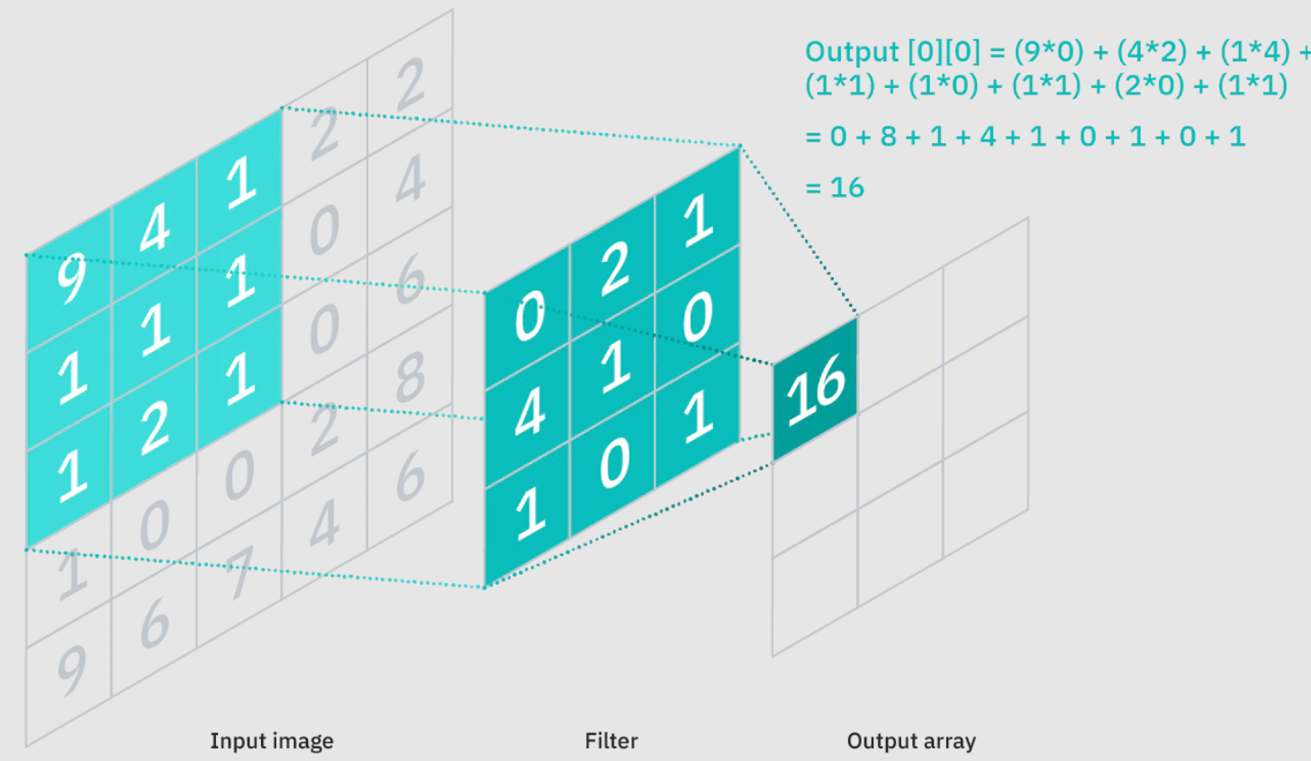
CNN – Convolutional Layer - EXAMPLE

Slide 14
CNN – Convolutional Layer - EXAMPLE
Image size → 5x5 px
Filter size → 3x3 px
CONVOLUTION OPERATION:
9*0 + 4*2 + 1*1 +
1*4 + 1*1 + 0*1 +
1*1 + 2*0 + 1*1 = 16
This values represent the weights and randomly assigned in the beginning of the TRAINING phase. THE AIM OF THE CNN is to update the weights and extract the features!

Slide 15
CNN – Convolutional Layer – EXAMPLE 2
Our filter →
1 | 0 | 1
0 | 1 | 0
1 | 0 | 1
1*1 + 1*0 + 1*1 +
0*0 + 1*1 + 1*0 +
0*0 + 0*0 + 1*1 = 4
The stride parameter determines how many pixels the filter is shifted after the previous convolution operation.
The Kernel/filter shifts 9 times because of Stride Length = 1 (Non-Strided), every time performing an elementwise multiplication operation between K (kernel) and the portion P of the image over which the kernel is hovering.
The filter moves to the right with a certain Stride Value till it parses the complete width. Moving on, it hops down to the beginning (left) of the image with the same Stride Value and repeats the process until the entire image is traversed.

Slide 16
CNN – Pooling Layer
Pooling layers, also known as downsampling, conducts dimensionality reduction, reducing the number of parameters in the input.
Similar to the convolutional layer, the pooling operation sweeps a filter across the entire input, but the difference is that this filter does not have any weights.
Instead, the kernel applies an aggregation function to the values within the receptive field, populating the output array.
There are two main types of pooling:
Max pooling:
As the filter moves across the input, it selects the pixel with the maximum value to send to the output array
Average pooling:
As the filter moves across the input, it calculates the average value within the receptive field to send to the output array

Slide 17
CNN – Pooling Layer Example max-pooling
Kernel → 3x3
Image → 5x5
Stride → 1
Max(3,3,2,0,0,1,3,1,2) = 3
Max(1,2,2,0,0,2,0,0,0) = 2

Slide 18
CNN – Pooling Layer Example max-pooling & avg-pooling
Kernel → 2x2
Image → 4x4
Stride → 2
(3+2+0+7)/4
= 3

Slide 19
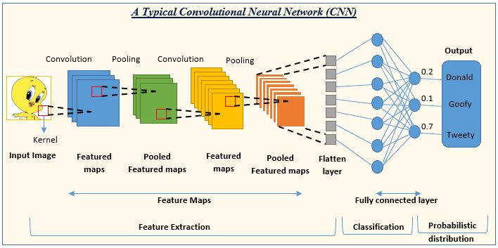
CNN – FC Layer
This layer performs the task of classification based on the features extracted through the previous layers and their different filters.
While convolutional and pooling layers tend to use ReLu functions, FC layers usually leverage a softmax activation function to classify inputs appropriately, producing a probability from 0 to 1.
in the fully-connected layer, each node in the output layer connects directly to a node in the previous layer

Slide 20
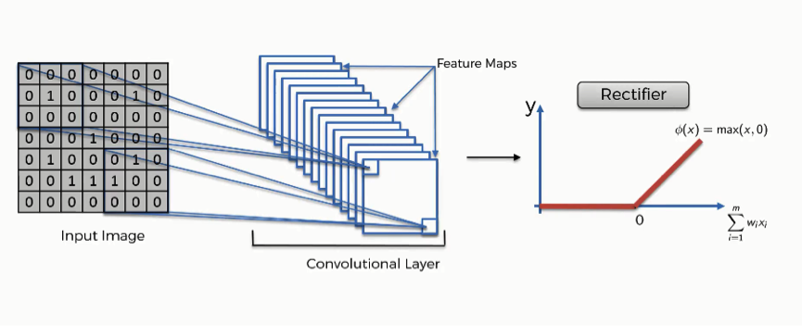
CNN – ReLU and Soft-max activation functions
The reason why the rectifier function is typically used as the activation function in a convolutional neural network is to increase the nonlinearity of the data set.

Slide 21
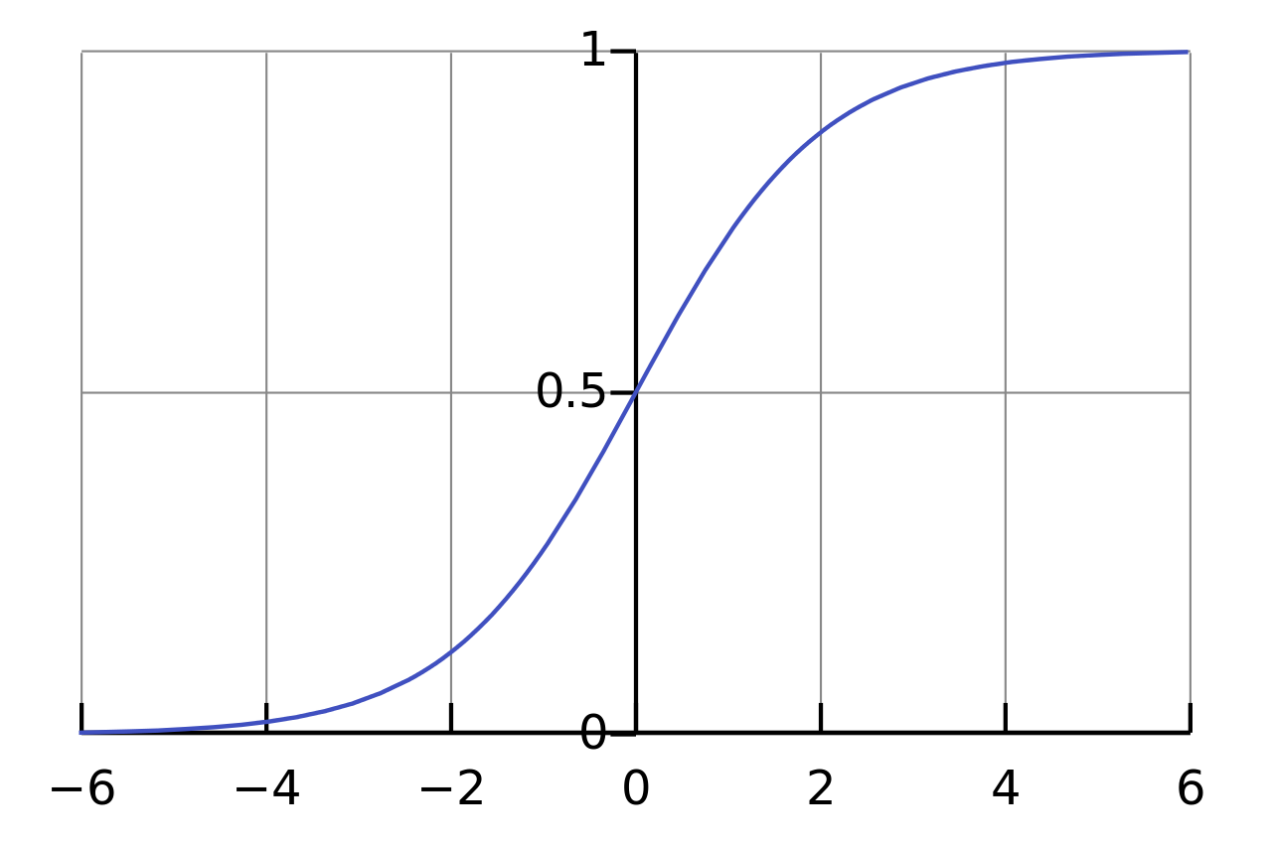
CNN – ReLU and Soft-max activation functions
It is mainly used to normalize neural networks output to fit between zero and one. It is used to represent the certainty “probability” in the network output
The softmax activation is normally applied to the very last layer in a neural net, instead of using ReLU, sigmoid, tanh, or another activation function. The reason why softmax is useful is because it converts the output of the last layer in your neural network into what is essentially a probability distribution.

